Slide 1
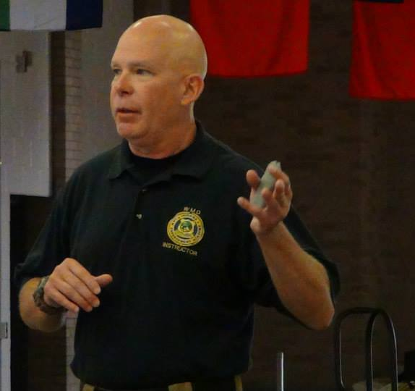


Fortress Preparedness Services
About Us
Fortress Preparedness Services provides disaster preparedness guidance for businesses related to all man-made or natural disasters. Including risk assessments, emergency operations plans, policies, education and drills.
Jay Dotson- Owner and Senior Consultant
Background:
Mr. Dotson has been involved in major weapons of mass destruction and incident command system-300 & 400 training projects at; Denver Police Academy, Los Angeles Police Academy, Seattle Police Academy, Chicago Fire Academy, Fort Knox, Fort McCoy and Fort Grayling.
Contact Us
Phone: 765-729-3502
Email: fortresspreparedness@gmail.com
fortress-preparedness.com
Visit our website for on-line active shooter awareness training!
The owner of FPS has 30yrs of experience in hospital security, law enforcement, environment of care and joint commission’s standards. He is an instructor in active shooter response, martial arts/ self-defense, the national incident management system (NIMS), the incident command system (ISC) 300 & 400, hazardous materials decontamination, weapons of mass destruction awareness and is a recognized trainer through the Indiana Law Enforcement Academy. In addition is a former training consultant for the Indiana Department of Homeland Security and the Center for Domestic Preparedness.
Fortress Preparedness Services
420 S. High St.
Suite 120
Muncie, IN 47305
“If not us, then who”?
Notes:
To change this brochure, replace our sample content with your own. Or, if you'd rather start from a clean slate, press the New Slide button on the Home tab to insert a new page. Now enter your text and pictures in the empty placeholders. If you need more placeholders for titles, subtitles or body text, copy any of the existing placeholders, then drag the new one into place.

Slide 2

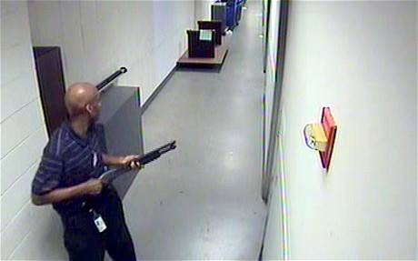
Best Practices
Disaster preparedness assists businesses in proactively responding to a disaster, minimizing loss of revenue, enhancing public image while protecting staff and physical assets. Planning can reduce business down-time and insurance costs.
“After conducting a risk assessment businesses should have written plans for identified threats, provide education to staff and conduct drills to remedy weaknesses”.
Active shooter incident can strike any type of business.
Our active shooter awareness program focuses on recognizing a credible threat and minimizing the risk, prior to an attack.
Our Products and Services
Get Results
Hazard Vulnerability Assessments
Policy Guidance and Creation
Drills and Exercises
Incident Command System
Active Shooter Awareness
Aggression Management/ Conflict Resolution
Workplace Violence Programs
Self-Defense Training
Hazardous Materials Decontamination
Weapons of Mass Destruction
Specializing in Weapons Specializing in Emergency Preparedness Programs
At Fortress Preparedness Services we meet with you one on one to discuss your priority list. Which gives us the opportunity to customize the project to match your specific needs.
Who we Serve:
Completive Edge
Industry/ Private Businesses
Hospitals- Emergency Preparedness/ Security Departments
Behavioral Care Facilities
Long-Term Care
Homecare Providers
Surgical Centers
Schools/ Universities
Due to low overhead and streamlined staffing our fees can be adapted to fit into your budget.
Please contact us for a price quote today.

